Slide 1
Stainless steel piping's presentation
28th December 2016

Slide 2
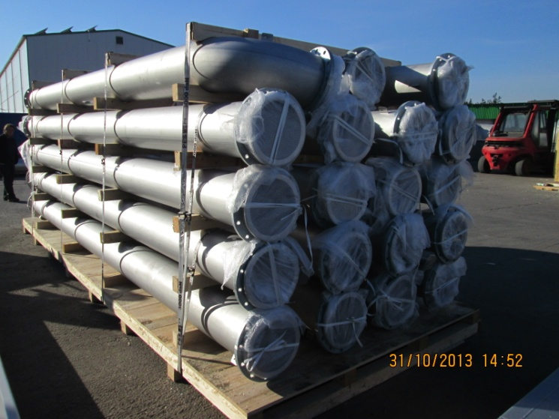
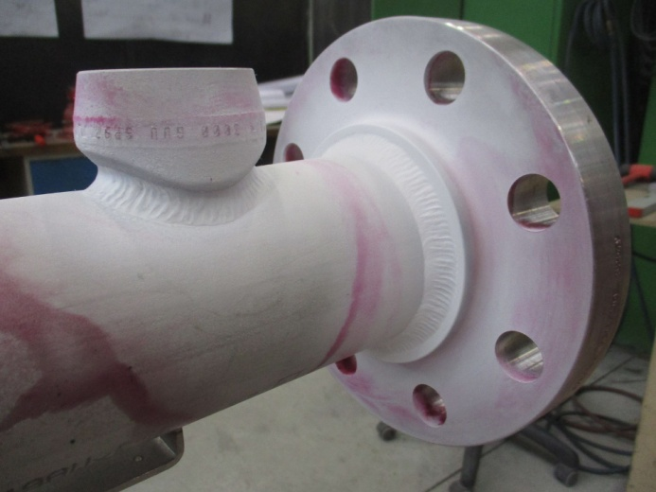
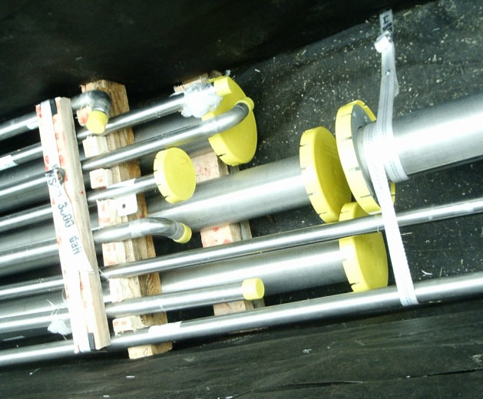
Typical stainless steel piping's made in 2JCP
Pipe diameter from 1“ to 12“ (25 to 305mm)
Wall thickness from sh5 to ch80 (1,65 tom 12,7mm)
Typical alloys are austenite stainless steel as AISI 304 or 316 type
but we are also qualified for a ferrite or
duplex steels and nickel alloys
and theirs combinations
Main manufacturing standards used
For non-pressure piping
ISO 15614-1
ASME IX code
AWS D1.6
Specially for pressure piping's
PED 97/23/CE directive
ASME B31.1 code
ASME B31.3 code
Man Power
48x certified TIG welders
17x certified VT/DPT inspectors
5x certified UT/X-RAY/LT inspectors

Slide 3
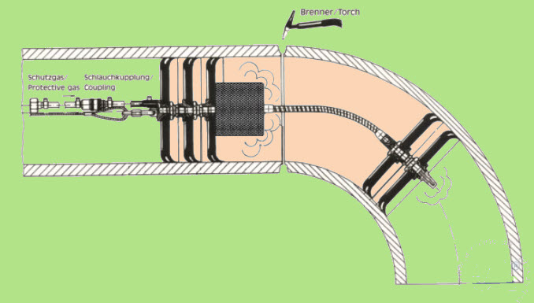
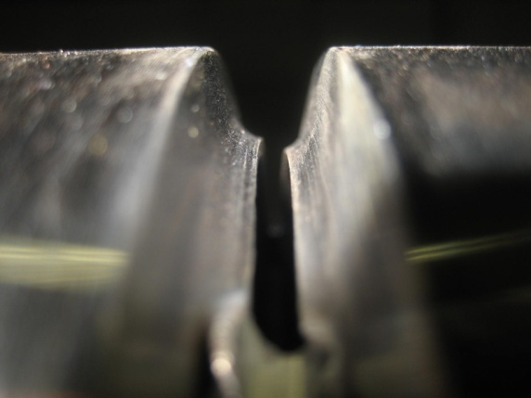
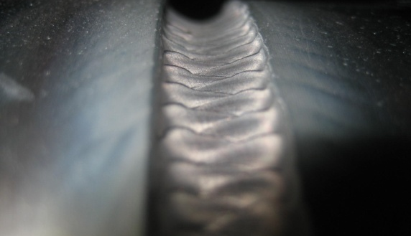
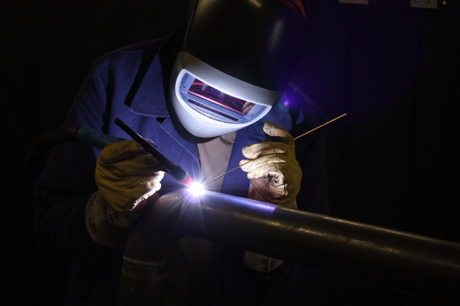
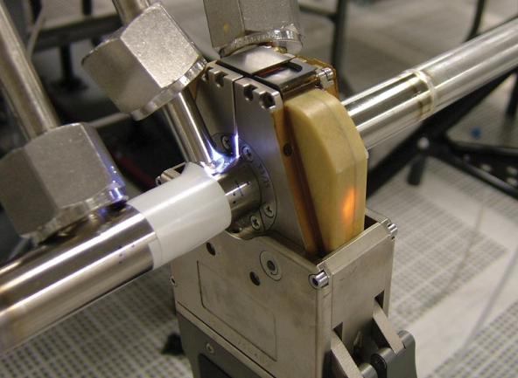
2JCP Manufacturing process
All piping's are welded by TIG welding process
Small bore piping up to 2“ (50mm) by orbital head
Bigger sizes by manual welding
The internal corrosion resistance can be suited by choice of purging gas type, we are qualified for following types
100% Argon
98 % Argon+2% Hydrogen
10% Nitrogen+90 % Hydrogen
All external surfaces and welds can be cleaned by a wet passivation at nitric acid, we can offer:
Local weld paste passivation or
complete surface passivation applied by spraying

Slide 4
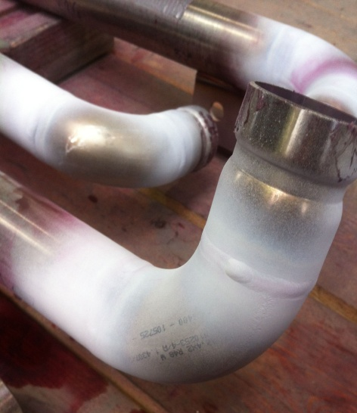
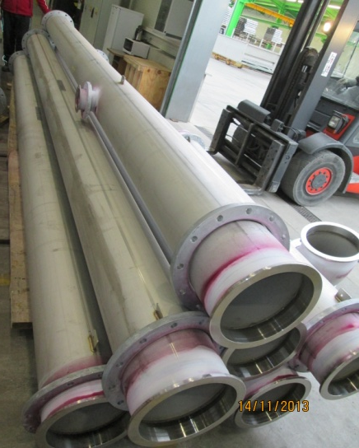
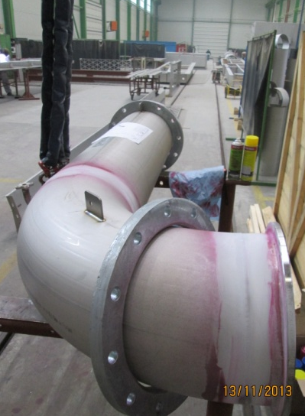
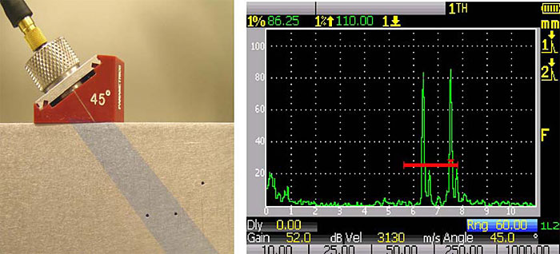
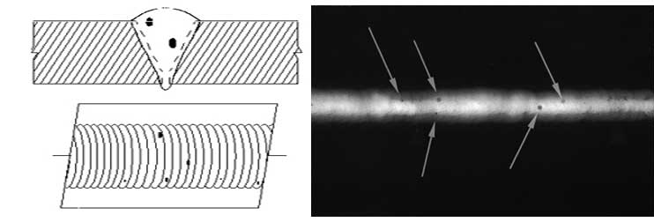
2JCP Inspection process
All piping's are visually inspected
external surface and welding (e.g. weld size, surface smoothness and lack of contamination)
Internal root quality by video-scope or mirrors (e.g. penetration, oxide coloring, residual dust)
Customers commonly ordering a dye penetration testing on butt welds
For demanding application we can offer a extended testing by
Ultrasonic testing, for thick wall piping's
X-Ray testing, for thin wall piping's

Slide 5
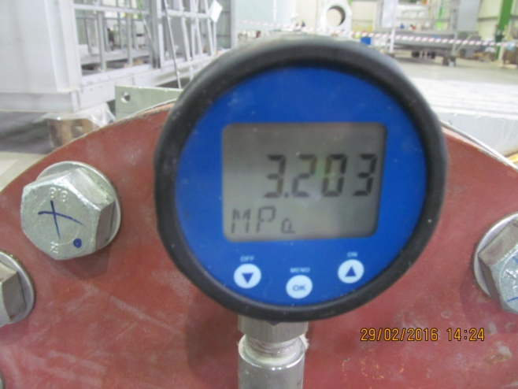
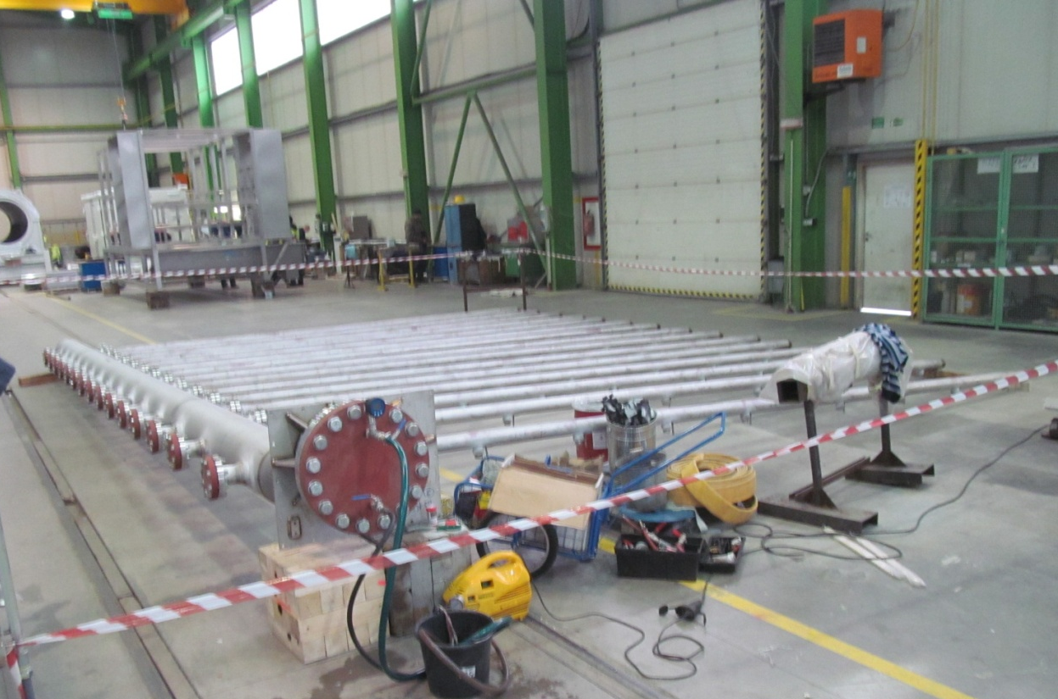
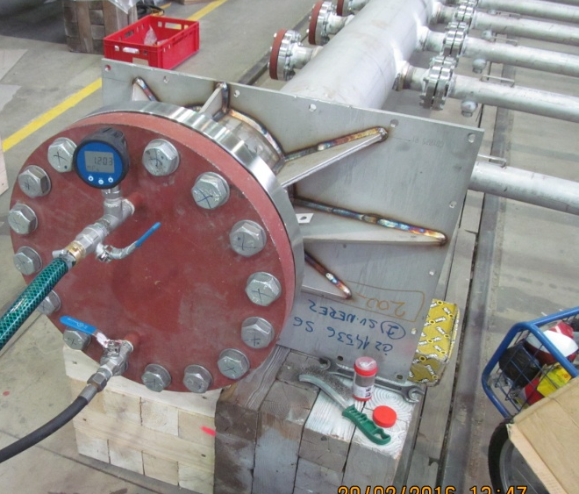
2JCP leaks testing process
Based on customer or standards (PED/ASME) requirements we perform following leak tests, typically up to 150bar
Smoke testing
Babble testing
Pneumatic pressure testing - by compressed air
Hydrostatic pressure testing – by pressurized water

Slide 6
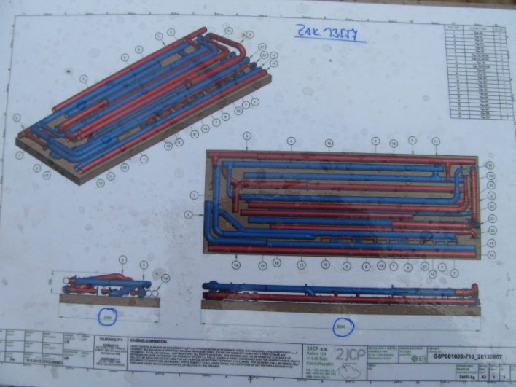
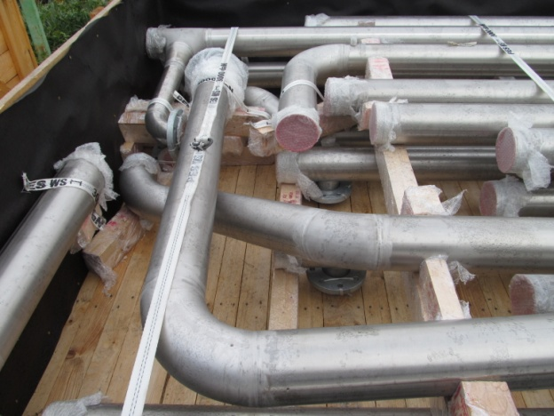
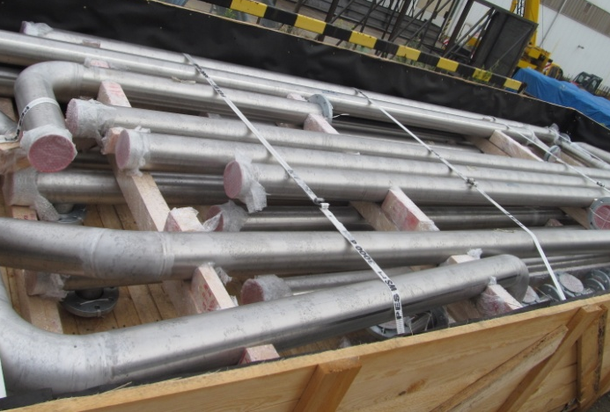
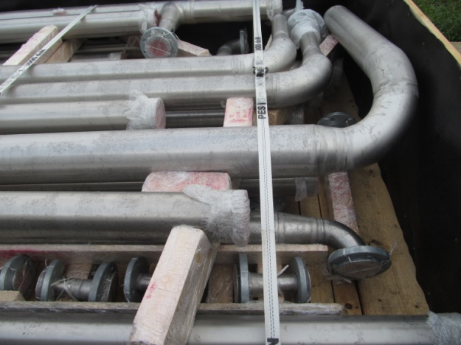
2JCP packing process
We are taking a special care on part packing and transport boxes traceability system before delivery to customer sites

Slide 7
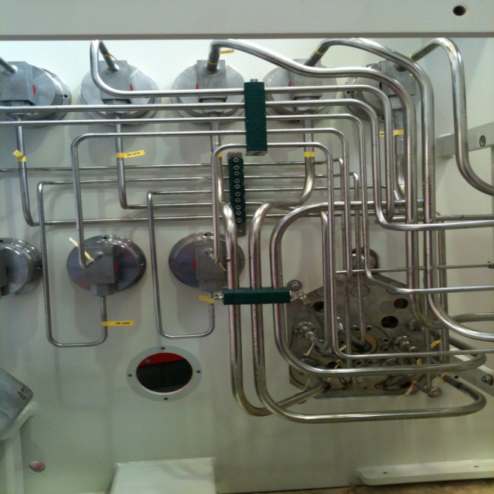
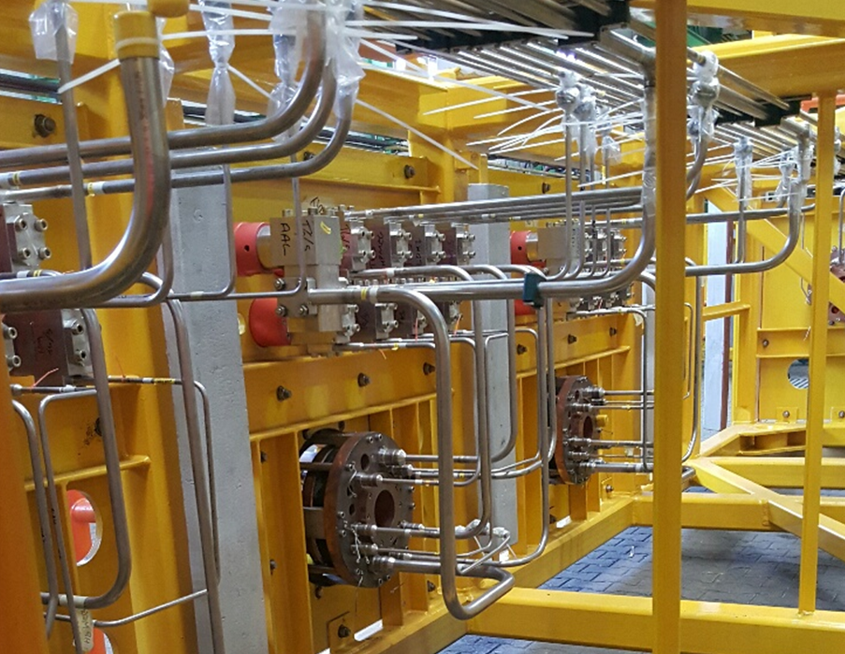
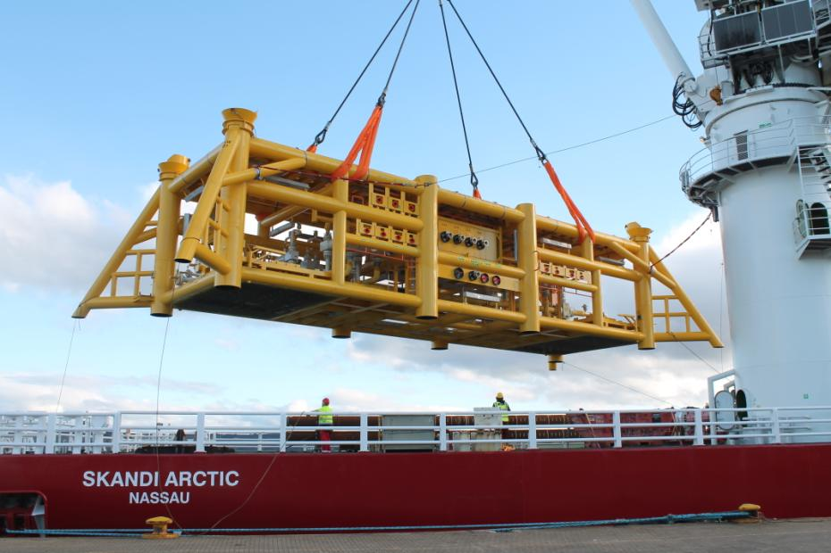
2JCP subsea projects
piping system design - BTS
clean room area – 3200 sqm
high pressure testing – up to 800bar
all fabrication and testing equipment in house

Slide 8
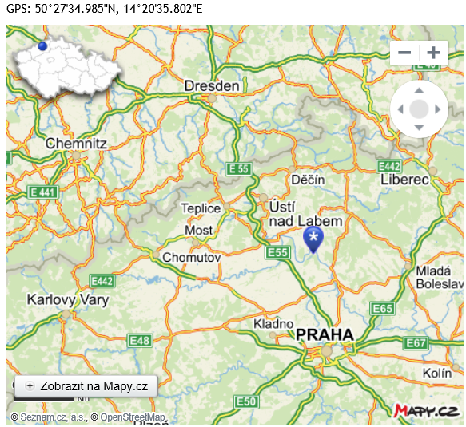
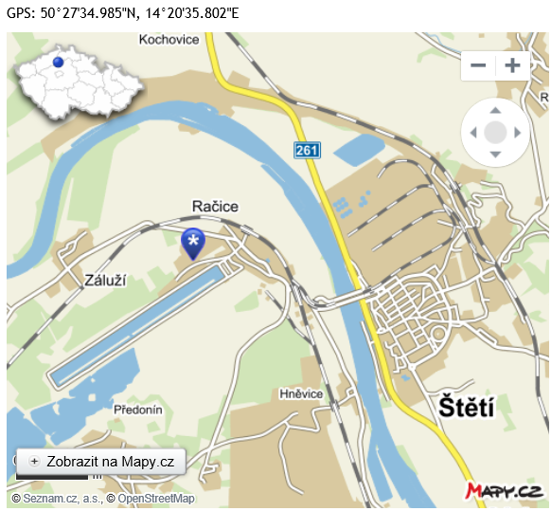
CONTACTS
2 JCP a.s. Račice 126, 411 08 Štětí, Czech Republic T. +420 416 857 511 Fax: +420 416 857 533 e-mail: 2jcp@2jcp.cz Web: www.2jcp.cz

